Slide 1
PYTHON WITH AI
Prepared by Sir Haroon

Slide 2
LECTURE 29
EXPLORING TKINTER IN PYTHON

Slide 3
INTRODUCTION TO TKINTER
tk: it is a short name for the tkinter library. It allows us to write tk instead of tkinter everytime. Tk() is the blank window where we place our GUI components. For example,

Slide 4

INTRODUCTION TO TKINTER
2. TK: creates the main application window. Every Tkinter program starts by creating this window.

Slide 5

INTRODUCTION TO TKINTER
3. Mainloop: Keeps the window open and waits for the user to ineract with it. Without tkinter, window appears and immediately closes.

Slide 6
INTRODUCTION TO TKINTER
4. Label: Used to display text or images on the window.
5. Button: A button is a clickable widget that performs an action when the user clicks it.

Slide 7
INTRODUCTION TO TKINTER
6. Entry: An entry is one line text box where you can type data
7. Frame: A frame is a container used to organize other widgets like labels, widget and entry boxes

Slide 8

INTRODUCTION TO TKINTER
8. StringVar: a special variable used to store and update text in tkinter widgets automatically.
9. Pack(): It places a widget inside the window automatically.

Slide 9
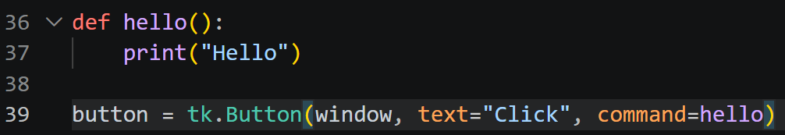
INTRODUCTION TO TKINTER
10. Grid: Arranges widgets into a table. Similar to rows and columns.
11. command: This option tells a button which function to execute when it is clicked.

Slide 10

INTRODUCTION TO TKINTER
12. get: retrieves the value entered by user from an entry widget.
13. delete: removes text from an entry widget.

Slide 11
INTRODUCTION TO TKINTER
14. insert: adds text into an entry widget at a specific position.
Now we will make a student marksheet and use all the tools we have learned till now.

Slide 12
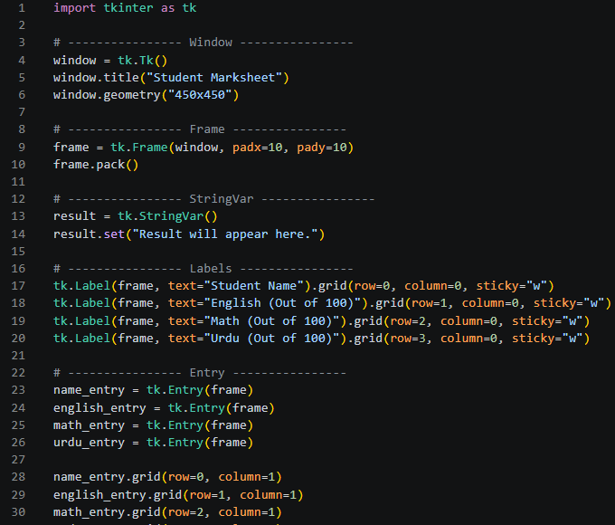
MARKSHEET PROGRAM LINE 1-30

Slide 13
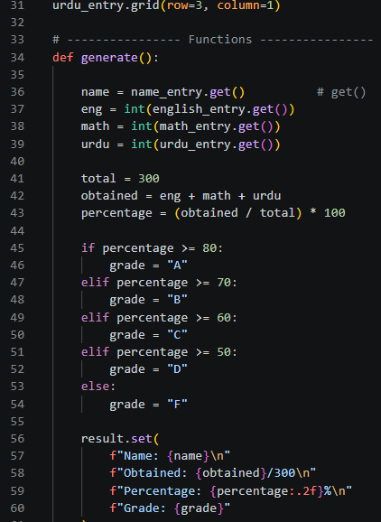
MARKSHEET PROGRAM LINE 31-60

Slide 14
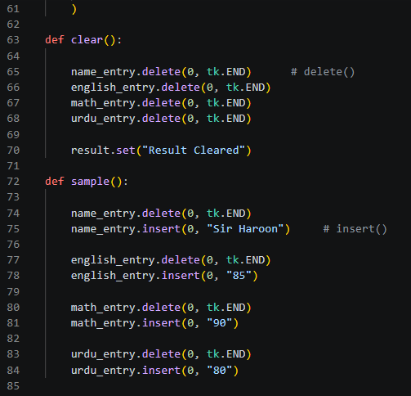
MARKSHEET PROGRAM LINE 61-85

Slide 15
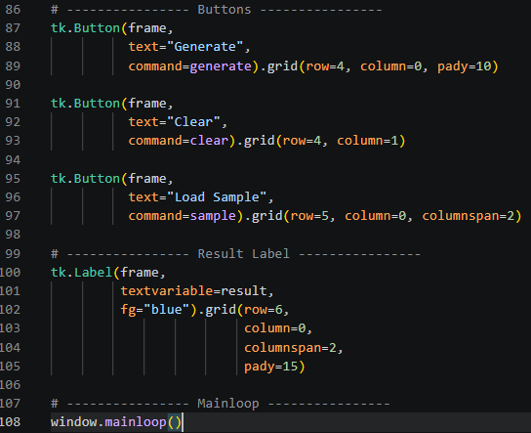
MARKSHEET PROGRAM LINE 86-108

